Slide 1
“Agricultural Crop Health Monitoring Using a Mobile Robot.”

Slide 2
AIM
Design and Development of a Mobile Robot which can detect the disease of the crops and spray the respective pesticide.
10-Dec-20
<number>

Slide 3
OBJECTIVES
To design an automatic robot that can move around in the field.
To identify the defective and non-defective leaves of the plants in the field.
To classify the type of disease occurred on the plant leaves.
To spray relevant pesticides of the disease on the crops using the robot.
10-Dec-20
<number>

Slide 4
CONTENTS
Abstract
Introduction
Literature Survey
Block Diagram and Description
Hardware/ Software Design
Results
Advantages/Disadvantages/ Applications
Conclusion
References
Phase Wise Plan
10-Dec-20
<number>

Slide 5
ABSTRACT
The project illustrates the implementation of a complete agricultural robot for farming. This is developed by the integration of an ARM controller, a set of sensors for navigation between rows, DC Gear Motor. The new technologies can serve efficiently for many problems by overcoming the limitations of the previous one. The system incorporates ultrasonic sensors to control the motion of the agricultural robot as well as the operations to perform. Ultrasonic sensor-based row guidance with distance measuring to drive an agricultural robot through the row crops in the field. The new real-time control to avoid collision and advancing towards the target at row end. Nowadays many industries are using robots to help human beings. MATLAB based image processing technique with image enhancement by enhancing the contrast and image segmentation by K means clustering along with the classification of multiple diseases and healthy leaves using Multi Class SVM. Image acquisition using live streaming through ESP32 Camera Module.
10-Dec-20
<number>

Slide 6
INTRODUCTION
In our nation, approximately 215.6 million acres of soil are irrigated crop region.
The Economic Survey says that there is a need to improve farm mechanization in the nation.
The farmers are facing significant issues in managing pest infestation. Pests are undesirable insects or germs that interfere with human activity and can bite, ruin food plants. Effective control of pests needs some understanding of pests and their habitats.
10-Dec-20
<number>

Slide 7
CONTINUED
While spraying pesticides around fields, the main disadvantages with regard to this method are: the pesticide may come into contact with the farmer, which may trigger skin cancer and asthma illnesses.
In this project, an automated robotic system is designed that can spray pesticides in restricted quantities after the pests are discovered to solve the above-mentioned problems.
<number>
Notes:
<number>

Slide 8
CONTINUED
Using this form of robots Time consumption is decreased in spraying the pesticide liquid and it will also assist farmers to decrease the workload and in any season and conditions to do job.
<number>
Notes:
<number>

Slide 9
LITERATURE SURVEY
[01] G.R. GAYATHIRI, DR. M.G.SUMITHRA, " Leaf Disease Diagnosis and Pesticide Spraying Using Agricultural Robot (AGROBOT)," IJARECE Volume 5, Issue 4, April 2016
Identification and collection of the photographs of crops using a camera.
Images are preprocessed, transformed and clustered and then are sent to the processor as an input where the images are compared.
If the disease is detected automatic pesticide sprayer will spray the pesticides to the affected area.
PIC controller is used for the wheel control and the pesticide spraying.
MATLAB is used for the image processing to compare the preprocessed image with the clustering techniques like K-means clustering.
10-Dec-20
<number>

Slide 10
LITERATURE SURVEY
[02] Pvr Chaitanya, Dileep Kotte, A. Srinath, K. B. Kalyan, " Development of Smart Pesticide Spraying Robot," IJRTE ISSN: 2277-3878, Volume-8 Issue-5, January 2020
Robot model web camera is used to scan the crops using live feed of the crops and sent to video processor using Wi-Fi.
The video undergoes preprocessing and segmentation by suppressing unwanted distortions and removing noises.
Processed data is sent to the controller using a Bluetooth.
The spraying of pesticides is performed on the basis of the number of pests.
Raspberry Pi 3 is used for video processing.
The motion of the robot and pesticide is controlled by ATmega328p on an Arduino Microcontroller Board.
10-Dec-20
<number>

Slide 11
LITERATURE SURVEY
[03] I.H. Celen, E. Onler, E. Kilic, "A Design of an Autonomous Agricultural Robot to Navigate between Rows," International Conference of Electrical, Automation and Mechanical Engineering (EAME 2015).
An ultrasonic sensors based navigation system is used in this design to navigate between the rows of the field.
Arduino MEGA I/O is used to analyze data coming from the sensors and adjust motors based on such data.
Dual VNH2SP30 Motor Driver Carrier MD03A model DC motor card is used to run the motors so that control card can operate the robot.
10-Dec-20
<number>

Slide 12
LITERATURE SURVEY
[04] Siddhi S. Mane, Nikita N. Pawar, Sneha A. Patil, Prof. D.O. Shirsath, "Automatic Farmer Friendly Pesticide Spraying Robot with Camera Surveillance System," IRJET e-ISSN: 2395-0056 Volume: 07 Issue: 05 | May 2020
The robotic model provides facility to control the movement of agriculture vehicle in different direction and spraying pesticide on crops.
The robot is operated by a bluetooth module.
Bluetooth module, DC motors of the wheels and pesticide sprayer are interfaced to the PIC Microcontroller.
The input received by IR sensor through Bluetooth is used to control the wheels.
10-Dec-20
<number>

Slide 13
LITERATURE SURVEY
[05] Philip J. Sammons, Tomonari Furukawa and Andrew Bulgin, "Autonomous Pesticide Spraying Robot for use in a Greenhouse," ARC Centre of Excellence for Autonomous Systems School of Mechanical and Manufacturing Engineering The University of New South Wales, Australia | t.furukawa@unsw.edu.au | September 9, 2005.
Metal rails are used in this system for hassle free operation of the robot.
Proximity sensors are used to accurately detect the presence of the metal rails.
The drive system consists of a worm drive motor capable of a maximum speed of 0.26 m/s whilst driving on the heating rails. The motor is driven by a high powered PWM (Pulse Width Modulation) controller board, taking in an analogue signal from the microcontroller.
Onboard Ethernet connectivity allows for the future realisation of remote wireless control of the robot.
The valves are electronically controlled by the on-board microprocessor which receives input signals from infer-red sensors on the underside of the robot.
10-Dec-20
<number>

Slide 14
LITERATURE SURVEY
[06] Anand Mishra (2021). Multi Class Support Vector Machine (https://www.mathworks.com/matlabcentral/fileexchange/33170-multi-class-support-vector-machine), MATLAB Central File Exchange. Retrieved January 5, 2021.
This function can classify more than two classes which is limited in MATLAB SVM.
This is primary work and does not include plotting function for SVM.
This is version 3.0 of original function which removes some limitations of first & Second one.
10-Dec-20
<number>

Slide 15
LITERATURE SURVEY
[07] Manu BN (2021). Plant Leaf Disease Detection and Classification using Multiclass SVM Classifier (https://www.mathworks.com/matlabcentral/fileexchange/55098-plant-leaf-disease-detection-and-classification-using-multiclass-svm-classifier), MATLAB Central File Exchange. Retrieved January 5, 2021.
A MATLAB code to detect and classify diseases in plant leaves using a multiclass SVM classifier.
A MATLAB code is written to classify the leaves into one of the following types: 'Alternaria Alternata', 'Anthracnose', 'Bacterial Blight', 'Cercospora Leaf Spot' and 'Healthy Leaves'.
10-Dec-20
<number>

Slide 16
BLOCK DIAGRAM
ESP-32 CAMERA MODULE
POWER SUPPLY
PUMPING MOTOR
PESTICIDE
SPRAYER
SYSTEM
(USER PC)
LPC2148 ARM MICROCONTROLLER
DC GEAR
MOTOR
ULTRASONIC
SENSORS
WHEEL
CONTROL
Fig. Block diagram of the mobile robot.
10-Dec-20
<number>

Slide 17
BLOCK DIAGRAM DESCRIPTION
There are four main units namely:
Input Unit:
Input unit consists of the power supply Unit which provides power to each and every electronic component in the Robot.
The pesticide storage unit for storage of pesticide in liquid form.
Ultrasonic sensors.
Spray and Control Processing (Microcontroller):
The ARM Controller is the Heart of the Robot.
The Driver Circuit is connected to the ARM Controller which in turn is connected to DC gear Motors for the purpose of Driving the Robot.
The Pesticide Pump is used to transfer the pesticide from storage tank to the Sprayer head.
<number>

Slide 18
CONTINUED
Output Unit:
The Direction Control unit controls the direction of the robot.
The Spraying Unit Will sprays the pesticide in specified direction.
Image Processing Unit:
ESP-32 Camera Module gives the images captured to the user. In the user PC image processing is done using MATLAB Software. The classification of the disease is done using the five below steps:
Image Acquisition
Image preprocessing
Image Segmentation
Feature Extraction
Disese detection and classification
Multi-class SVM Classifier is used for the classification of the disease.
<number>
Notes:
<number>

Slide 19
TECHNICAL SPECIFICATION OF PROJECT
Hardware Specifications
LPC2148 ARM microcontroller is used. It has 32 KB RAM and 512 KB of ROM. it has a 10-bit ADC. We use its PWM feature to control the speed of DC motors.
HC-SR04 ultrasonic sensor: It provides a range from 2cm to 400 cm. We use this sensor for measuring the distance from the left, right and front side of the robot.
L293D driver IC is used. It can control two DC motors simultaneously in both directions. This IC can provide bidirectional drive currents of up to 600 mA. It can operate on voltages from 4.5 V to 36 V.
The DC gear motor provides high torque, because of the heavyweight of a robot, the dc geared motor is best for the robot.
The AI-Thinker ESP32-CAM module comes with an ESP32-S chip, a very small size OV2640 camera and a micro SD card slot. Micro SD card slot can be used to store images taken from the camera or to store files. This ESP32-CAM module can be widely used in various IoT applications. We used this for taking videos or pictures of plants.
Compass Sensor: This sensor detects the direction and rotation of the robot.
.
10-Dec-20
<number>

Slide 20
TECHNICAL SPECIFICATION OF PROJECT
Software Specifications
KeiL IDE is used for the programming.
The MATLAB is used to process the image and classify it as infected or normal leaf.
Proteus is used for the simulation of the circuit.
10-Dec-20
<number>

Slide 21
SIMULATION RESULTS
Straight Motion : As the distance displayed on the left and right side ultrasonic sensors is equal and no other obstacle is detected in front the robot continues in straight motion.
<number>
Notes:
<number>

Slide 22
Left Turn: As on the left side distance is increased compared to right robot turns left by slowing down left DC motor by varying PWM signal.
<number>
Notes:
<number>

Slide 23
Right Turn: As on the right side distance is increased compared to left robot turns left by slowing down right DC motor by varying PWM signal.
<number>
Notes:
<number>

Slide 24
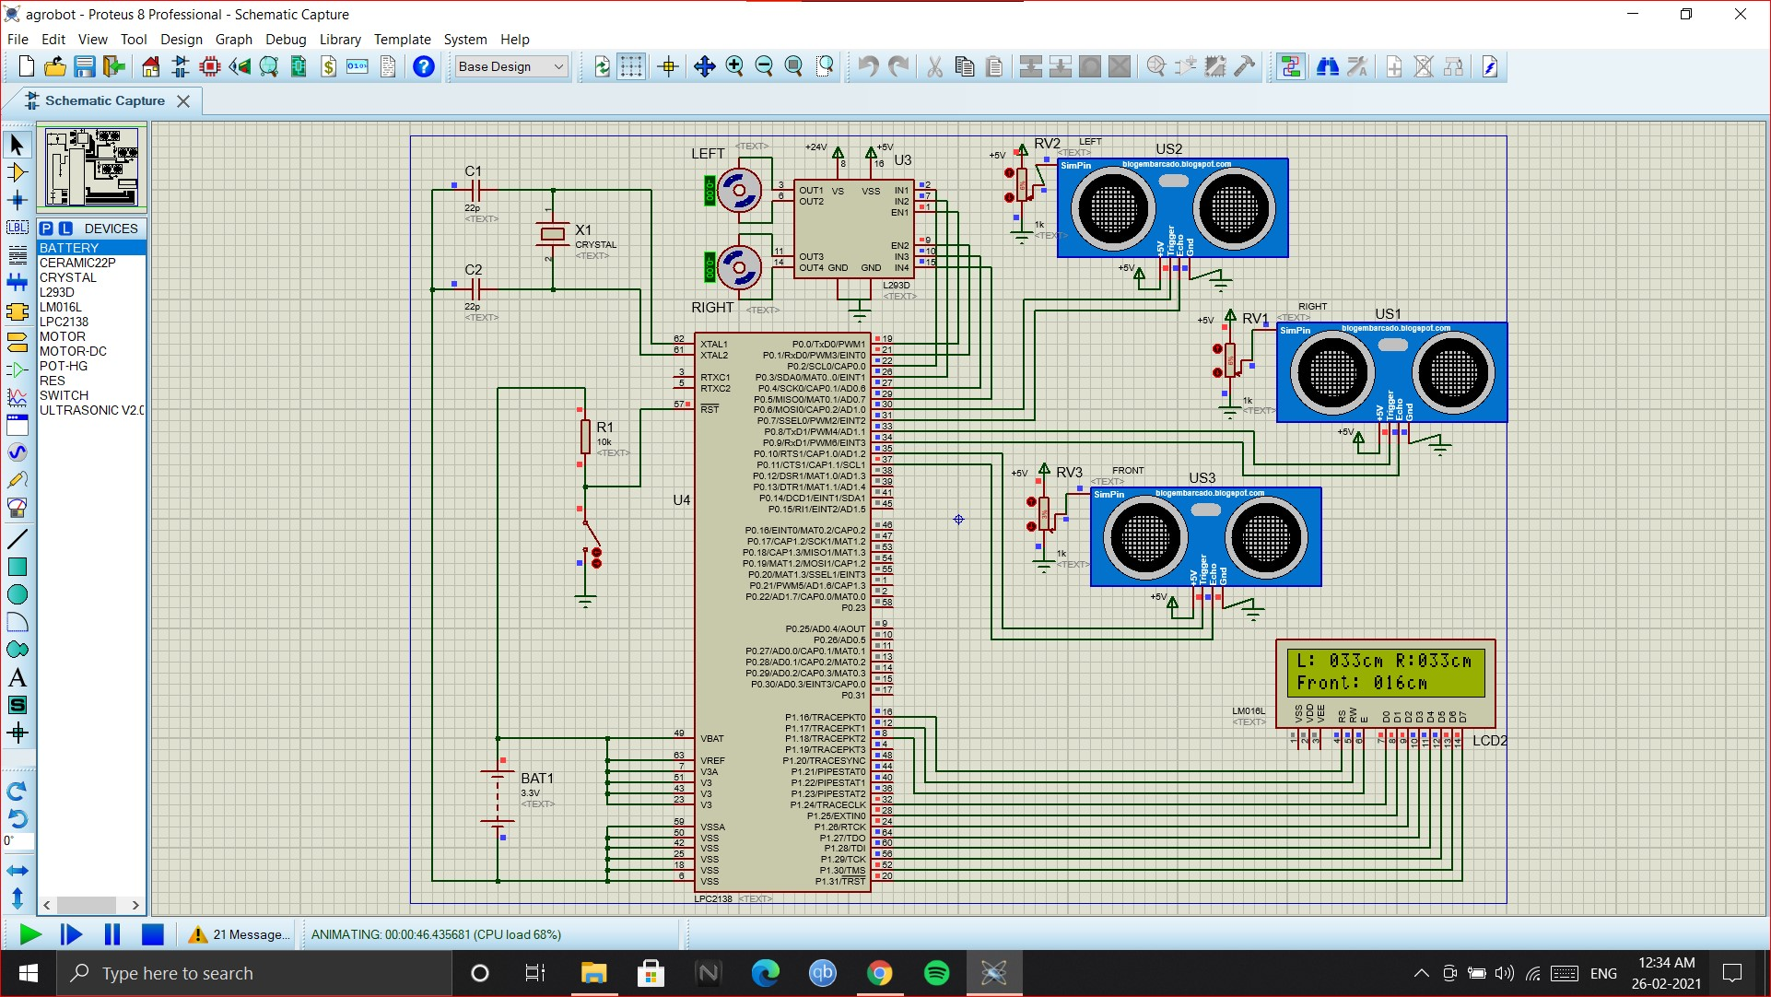
Obstacle Detection: Obstacles are detected by comparing the distance displayed on the front side ultrasonic sensor. When the obstacle is detected both the motors stop immediately.
<number>
Notes:
<number>

Slide 25
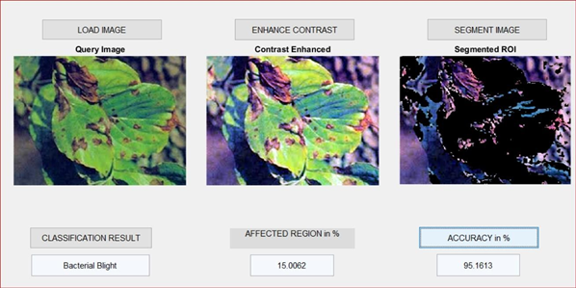
RESULTS-IMAGE PROCESSING
Image Processing results using MATLAB:
In image acquisition, the image is captured using ESP-32 cam and is sent to the user PC where in the MATLAB application, the leaf image is loaded. In image pre-processing the image gets enhanced resulting in a contrast enhanced image. Then in image segmentation, the image gets segmented by region of interest. Then later in feature extraction and classification disease name is detected using Support Vector Machine Multi-class Classifier and it also calculates the affected region and accuracy in percentage. K-Means Clustering method is used in the classification process.
<number>

Slide 26
EXPECTED ON-FIELD RESULTS
Robot Movement result:
First, for collecting the images of the plant leaves for the detection of the defective and not-defective leaves the robot will travel around the agricultural field autonomously using the DC gear motors. Robot is expected to follow all the commands defined for its movements in the microcontroller after getting the feedback from the ultrasonic sensors.
Pesticide Spraying result:
After disease detection the robot will again travel around the field and is expected to spray the respective pesticide for detected disease on the infected crops using the pumping motor mounted on the robot.
<number>

Slide 27
ADVANTAGES, DISADVANTAGES & APPLICATIONS
Advantages
The wireless operation will eliminate the health issues and would even save farmers from tedious work. It will have less use of manpower.
Efficient and health-conscious operation due to remote sensing.
This Robot is expected to be an all-terrain robot.
Disadvantages
During the rainy season the sloppiness would reduce the speed of the robot.
All the electronics components need to be covered properly else environmental changes could alter the output.
The system is bulky.
Applications
Plants can be protected in gardening farms from infections.
In Agricultural fields, farmers can use the robot for pest control.
10-Dec-20
<number>

Slide 28
CONCLUSION
In this project, an agricultural robot is designed, which could navigate between rows and at the end of the row turn to the next row autonomously. The proper detection of the disease using image processing is done using the Multi-class SVM Classifier. Spraying of the respective pesticides for the disease can be done throughout the field with the help of a pumping motor mounted on the mobile robot, this process will not require much help of manpower.
10-Dec-20
<number>

Slide 29
REFERENCES
[1] G.R. GAYATHRI, DR. M.G.SUMITHRA, " Leaf Disease Diagnosis and Pesticide Spraying Using Agricultural Robot (AGROBOT)," IJARECE Volume 5, Issue 4, April 2016
[2] Pvr Chaitanya, Dileep Kotte, A. Srinath, K. B. Kalyan, " Development of Smart Pesticide Spraying Robot," IJRTE ISSN: 2277-3878, Volume-8 Issue-5, January 2020
[3] Celen, Ilker & Onler, Eray & Kiliç, Erdal. (2015). A Design of an Autonomous Agricultural Robot to Navigate between Rows. 10.2991/eame-15.2015.97.
[4] Siddhi S. Mane, Nikita N. Pawar, Sneha A. Patil, Prof. D.O. Shirsath, "Automatic Farmer Friendly Pesticide Spraying Robot with Camera Surveillance System," IRJET e-ISSN: 2395-0056 Volume: 07 Issue: 05 | May 2020
[5]Sammons, Phil & Furukawa, Tomonari & Bulgin, Andrew. (2005). Autonomous Pesticide Spraying Robot for use in a Greenhouse.
[6] Anand Mishra (2021). Multi Class Support Vector Machine (https://www.mathworks.com/matlabcentral/fileexchange/33170-multi-class-support-vector-machine), MATLAB Central File Exchange. Retrieved April 29, 2021.
[7] Manu BN (2021). Plant Leaf Disease Detection and Classification using Multiclass SVM Classifier (https://www.mathworks.com/matlabcentral/fileexchange/55098-plant-leaf-disease-detection-and-classification-using-multiclass-svm-classifier), MATLAB Central File Exchange. Retrieved January 5, 2021.
10-Dec-20
<number>

Slide 30
REFERENCES
[8] S. K. Tichkule and D. H. Gawali, "Plant diseases detection using image processing techniques," 2016 Online International Conference on Green Engineering and Technologies (IC-GET), 2016, pp. 1-6, doi: 10.1109/GET.2016.7916653.
[9] S. Lagad and S. Karmore, "Design and development of agrobot for pesticide spraying using grading system," 2017 International conference of Electronics, Communication and Aerospace Technology (ICECA), 2017, pp. 279-283, doi: 10.1109/ICECA.2017.8212817.
[10] K. MURUGAN, B. J. SHANKAR, A. SUMANTH, C. V. SUDHARSHAN and G. V. REDDY, "Smart Automated Pesticide Spraying Bot," 2020 3rd International Conference on Intelligent Sustainable Systems (ICISS), 2020, pp. 864-868, doi: 10.1109/ICISS49785.2020.9316063.
[11] K. H.S. et al., "AgRobots (A Combination of Image Processing and Data Analytics for Precision Pesticide Use)," 2018 International Conference on Design Innovations for 3Cs Compute Communicate Control (ICDI3C), 2018, pp. 56-58, doi: 10.1109/ICDI3C.2018.00020.
[12] S. K. Pilli, B. Nallathambi, S. J. George and V. Diwanji, "eAGROBOT — A robot for early crop disease detection using image processing," 2015 2nd International Conference on Electronics and Communication Systems (ICECS), 2015, pp. 1684-1689, doi: 10.1109/ECS.2015.7124873.
[13] S. D. Khirade and A. B. Patil, "Plant Disease Detection Using Image Processing," 2015 International Conference on Computing Communication Control and Automation, 2015, pp. 768-771, doi: 10.1109/ICCUBEA.2015.153.
10-Dec-20
<number>

Slide 31
THANK YOU.
10-Dec-20
<number>

